Slide 1
WEB SCRAPING
HAMZA RANA 2022-BSSE-112
MUHAMMAD FARHAN 2022-BSSE-098
M.ZAID BIN ASIF 2022-BSSE-140
AHMAD RAZA 2022-BSSE-116

Slide 2
WHAT IS WEB SCRAPING ?
Web scraping is a technique used to extract information from websites. It involves fetching the content of a web page and then parsing that content to retrieve specific data, such as text, images, or links. This process can be automated using various programming languages and libraries, making it efficient for gathering large amounts of data from multiple sources quickly.

Slide 3
HOW WEB SCRAPER WORKS ?
1
2
3
FETCHING
PARSING
DATA STORAGE
Sending a request to the web server to retrieve the HTML content of a web page. This is typically done using libraries like requests in Python.
Analyzing the HTML structure to locate and extract the desired data. Tools like Beautiful Soup or lxml help in navigating and manipulating the HTML.
Once the data is extracted, it can be stored in different formats, such as CSV, JSON, or databases, for further analysis and use.

Slide 4
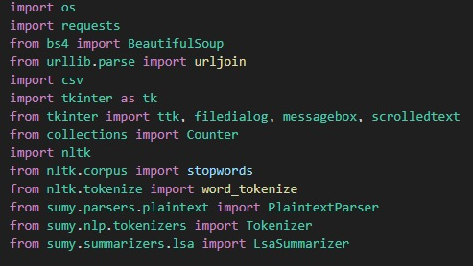
LIBRARIES WHICH ARE USED !

Slide 5
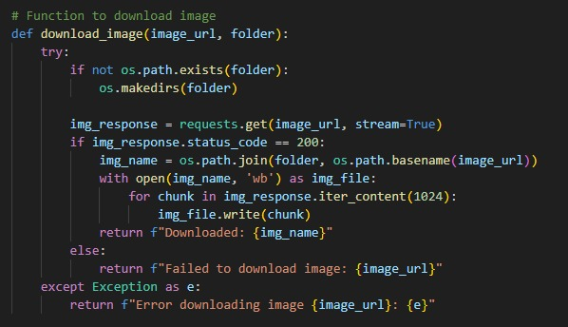
FUNCTION

Slide 6
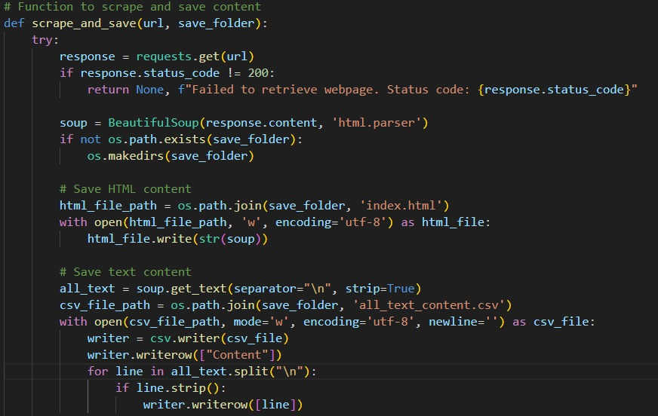

Slide 7
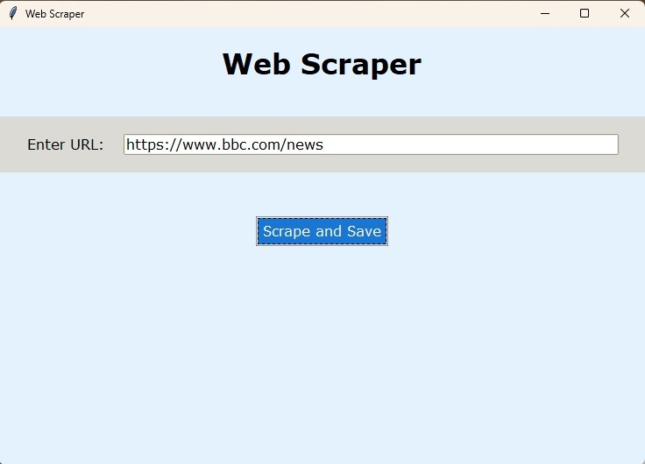

Slide 8
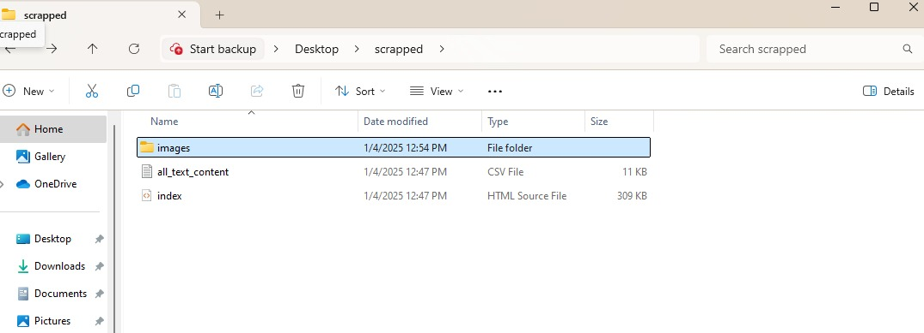

Slide 9
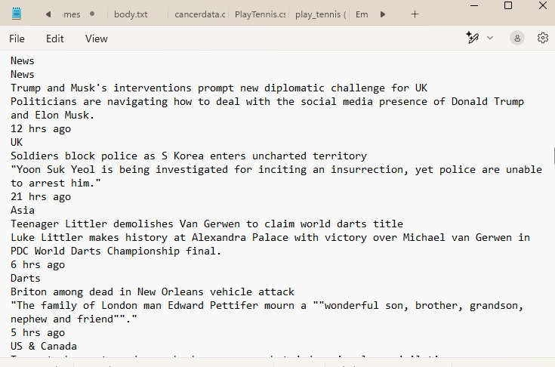
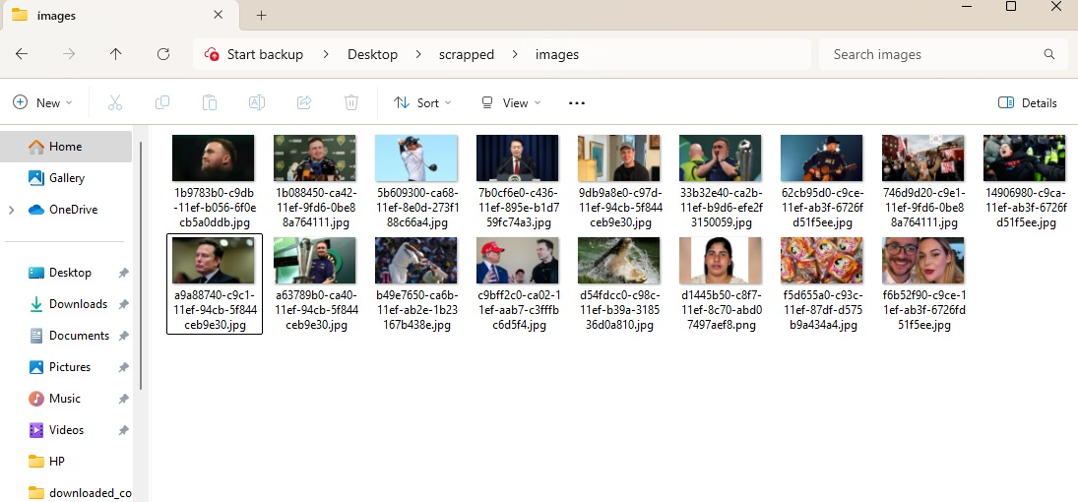
TEXT
IMAGES

Slide 10
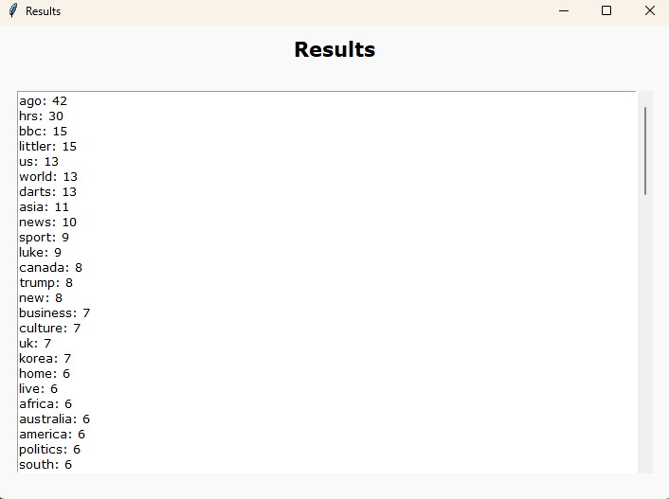
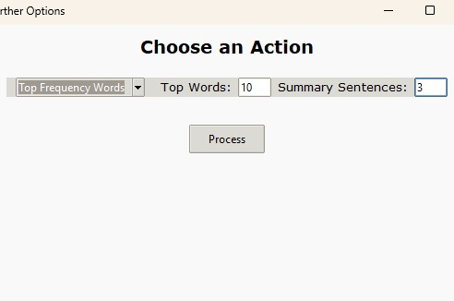
OTHER OPTIONS

Slide 11
APPLICATIONS OF WEB SCRAPING
Content Scraping
News Aggregation
Blog Aggregation
01
02
Price Monitoring
E-commerce
Financial Markets
03
Job Market Analysis
Job Listing Sites
Company Research
04
Sentiment Analysis
Product Reviews
Political Sentiment

Slide 12
APPLICATIONS OF WEB SCRAPING
Data Backup
Archiving Content: Creating backups of web content for preservation purposes, such as for historical documentation or personal use.
05
Academic Research
Data for Analysis: Researchers may scrape data from various sources for analysis and insights in areas like social science, economics, or public health.
06
07
Data Aggregation
Price Comparison
Travel Aggregators
08
Market Research
Competitor Analysis
Consumer Sentiment Analysis

Slide 13

PROS OF WEB SCRAPING
Cost-Effective
Flexibility
Wide Range of Applications
Data Collection:
Automated Data Gathering
Access to Real-Time Data

Slide 14
TOOLS FOR WEB SCRAPING
Octoparse : A no-code web scraping tool with a user-friendly interface.
ParseHub : A visual data extraction tool that works with web data and can handle dynamic content.
WebHarvy : A point-and-click web scraping software designed for users who are not familiar with coding.
Data Miner : A browser extension for Google Chrome and Microsoft Edge that allows users to scrape data from web pages directly
OutWit Hub : A data extraction tool that automates the scraping process for both static and dynamic web pages.
Apify : A cloud-based web scraping platform that provides ready-to-use scraping scripts (actors) and a scalable infrastructure

Slide 15

CONS OF WEB SCRAPING
1. Legal and Ethical Issues:
Terms of Service Violations
Data Privacy Concerns
2. Website Scraping Restrictions:
3. Data Quality Issues:
Inconsistent Data
Duplication

Slide 16
CONCLUSION
This project demonstrates the implementation for collecting data from websites, popular in research and business. It can help save time and provide valuable insights. However, it’s essential to be aware of ethical and legal issues.

Slide 17
……
THANK YOU
Notes:
模板来自于 http://docer.wps.cn

